Slide 1


dark web monitoring
Team Members
Shreyash rane
kashyap busa

Slide 2
Problem statement
The problem at hand is to design and implement an effective Dark Web Monitoring System that
can identify and track illegal activities, sensitive information leaks, and potential security threats
on hidden online platforms.

Slide 3

why we choose this problem?
as we know that dark web are built for crime, illegal data extraction, hacking, breaking security and facing trouble to human life.
so its important to monitor the dark website threat and criminal detection

Slide 4
solution
our dark web monitoring tool
the objective of our tool is to track and analyze activities that occur on the darkweb.

Slide 5
fUNCTIONALITY
w (wide surface) | User can coustomize the query. Organize and store diverse data seamlessly with specialized categorization.
r (real time alerting) | Triggered by specific parameters. ( datatype, email, keyword)
P (pawned) | Centralizied repository with continous datasearch, storing and alerting occurence for enhance pawn detection.
w (web archive) | Automatic data collection with user defined interface for capturing html code and snapshots from the darkweb.

Slide 6
web crawler
data analysis
spyder
dweb
tool
web archive
pawned
architecture
seach engine
query resolver
Connection
Ahima
Torch
i2P
TOR

Slide 7
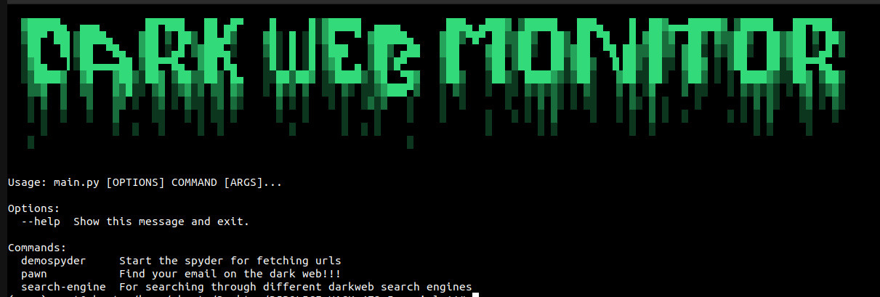
dweb tool

Slide 8
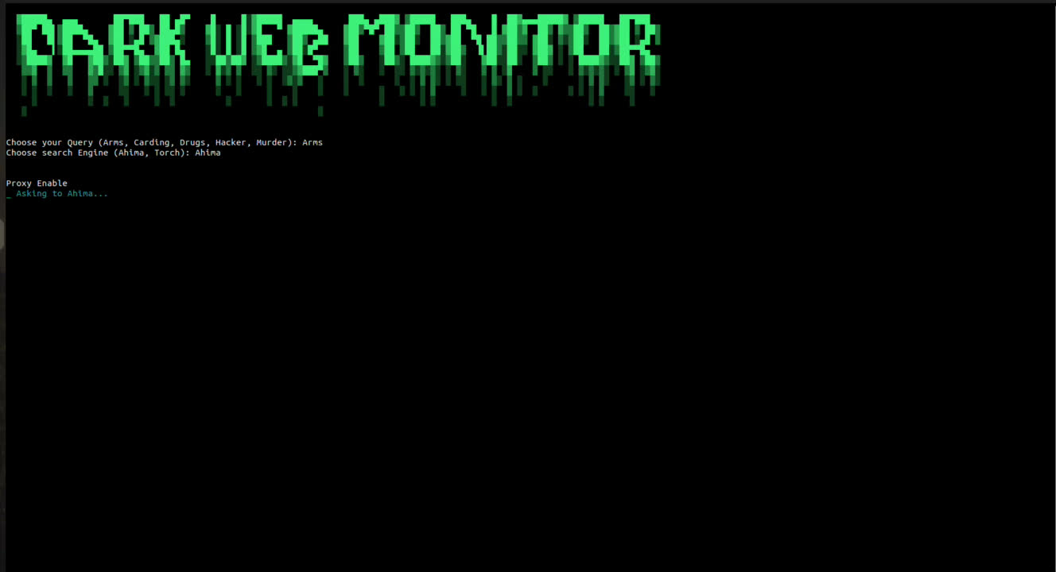
fetching url from search engines

Slide 9
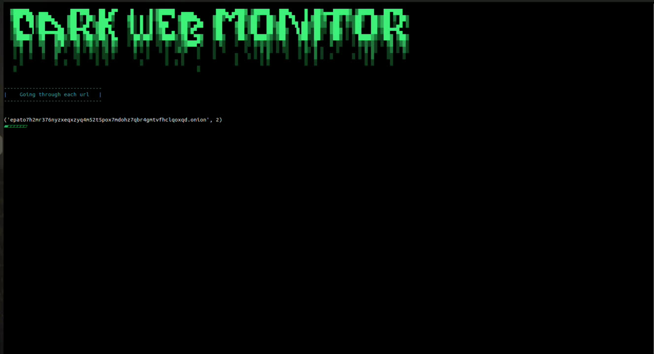
navigating onion sites and extracting source code

Slide 10

dark web identity check

Slide 11
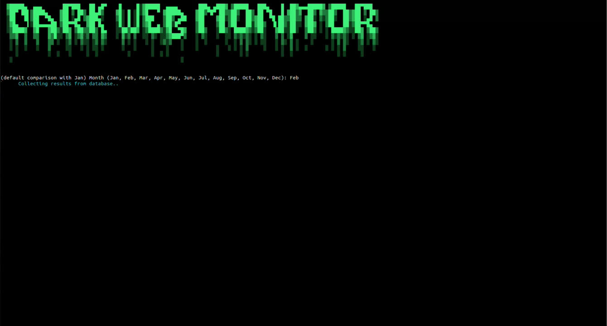
web archive

Slide 12
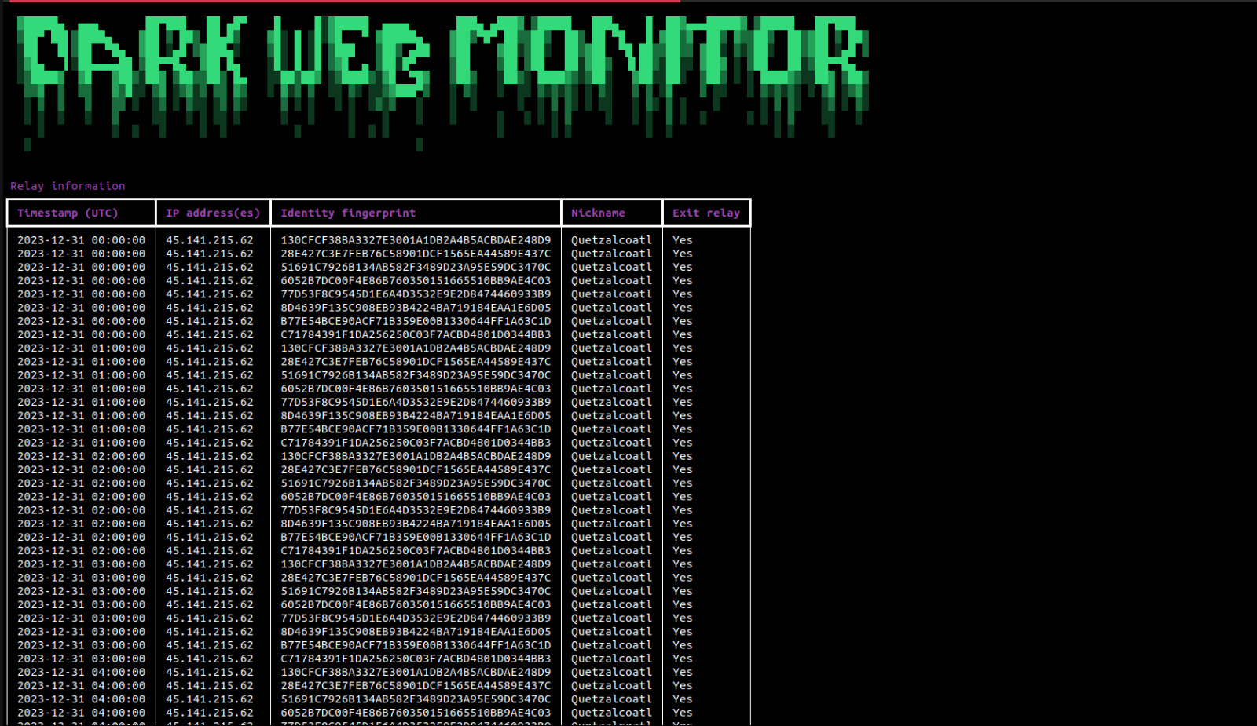
TOR relay search

Slide 13



comparison with dark owl and digital shadows
limited type of data
automate monitoring
actionable insight

Slide 14

thank
you !!!!

